Slide 1
DATA EXPRESS
Jui Nagarkar, Becky Lin, Yuying Li

Slide 2
WHAT IS DATA EXPRESS?
Data Express is a convenient team collaboration website that allows teams to work efficiently. Once a user signs into their account by logging in or creating a new account, the user can either create a new team or join an existing team. The user can also view their own profile which includes their username, email, and the teams that they are a part of.

Slide 3


WHAT WE USED:

Slide 4
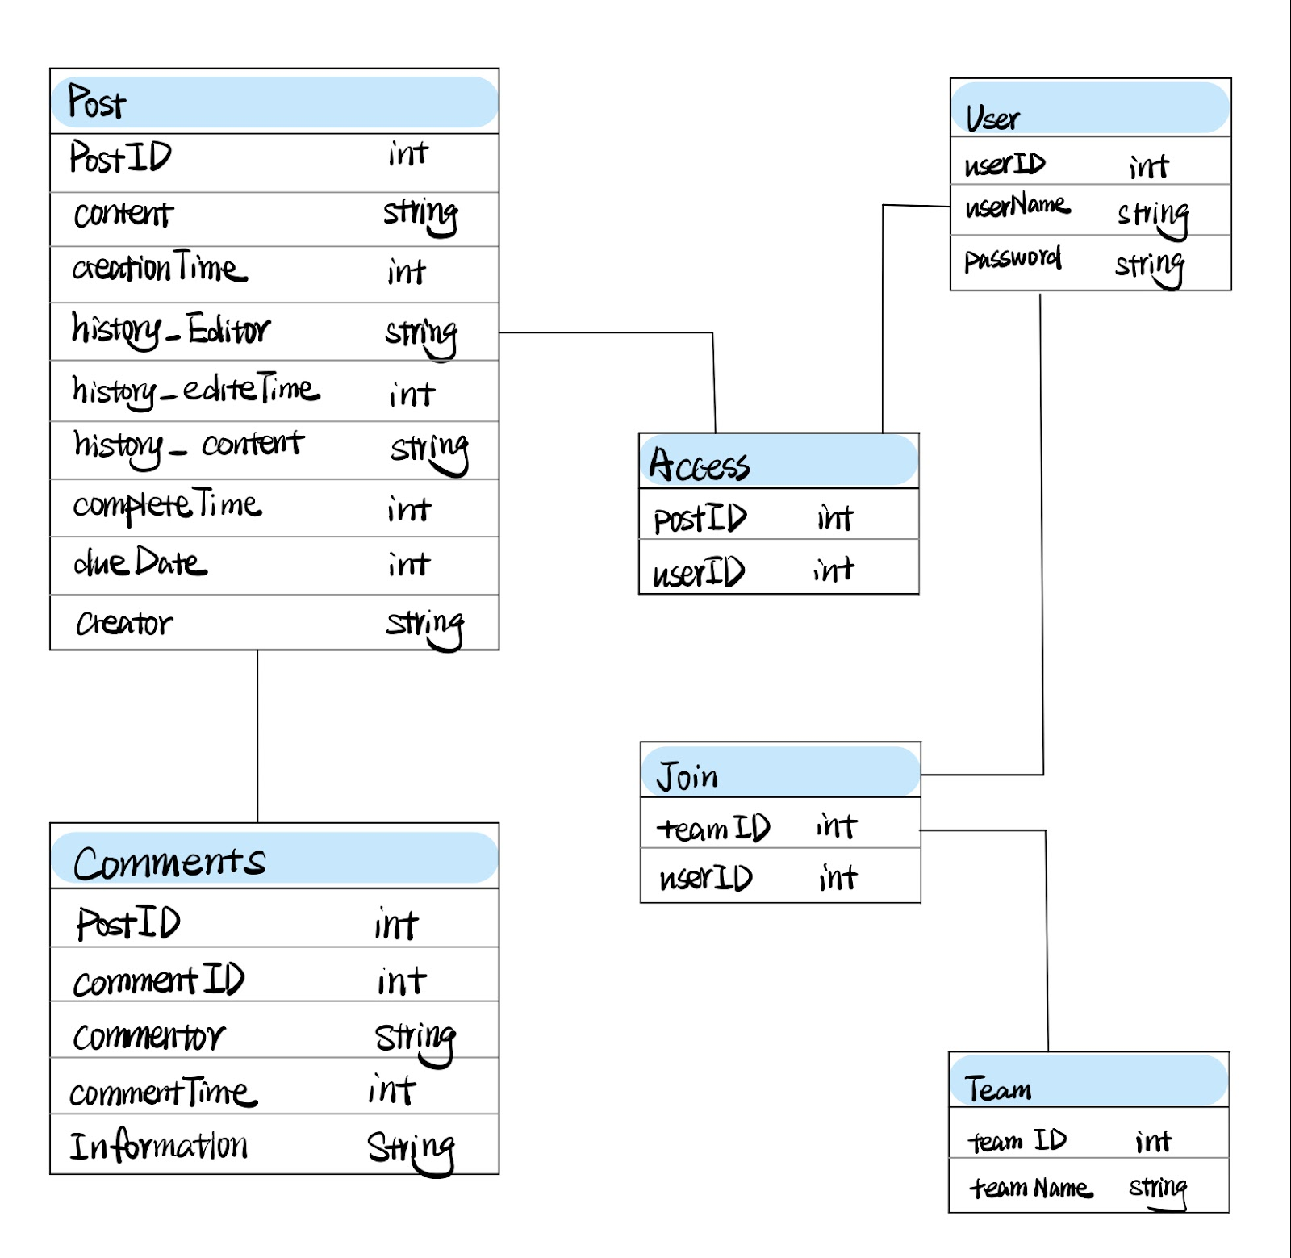
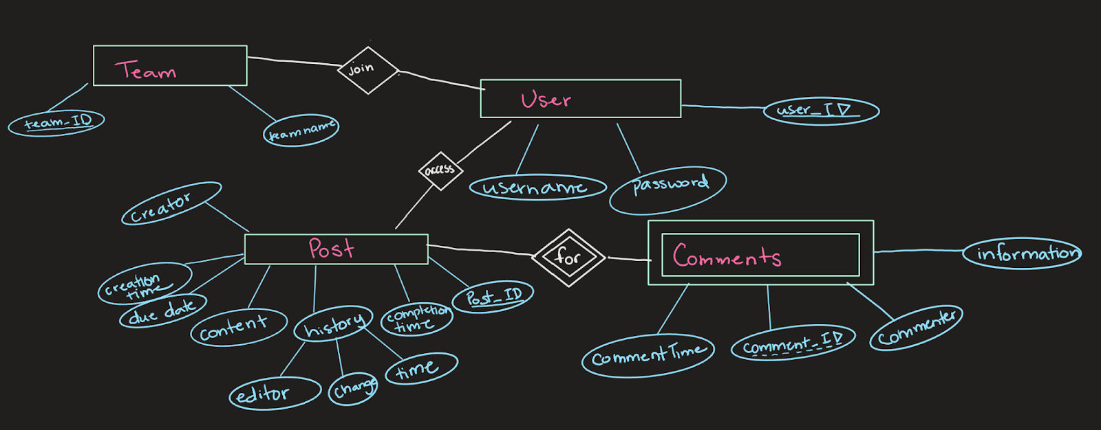
OUR DIAGRAMS:

Slide 5
DEMO TIME!
https://people.eecs.ku.edu/~b884l228/

Slide 6
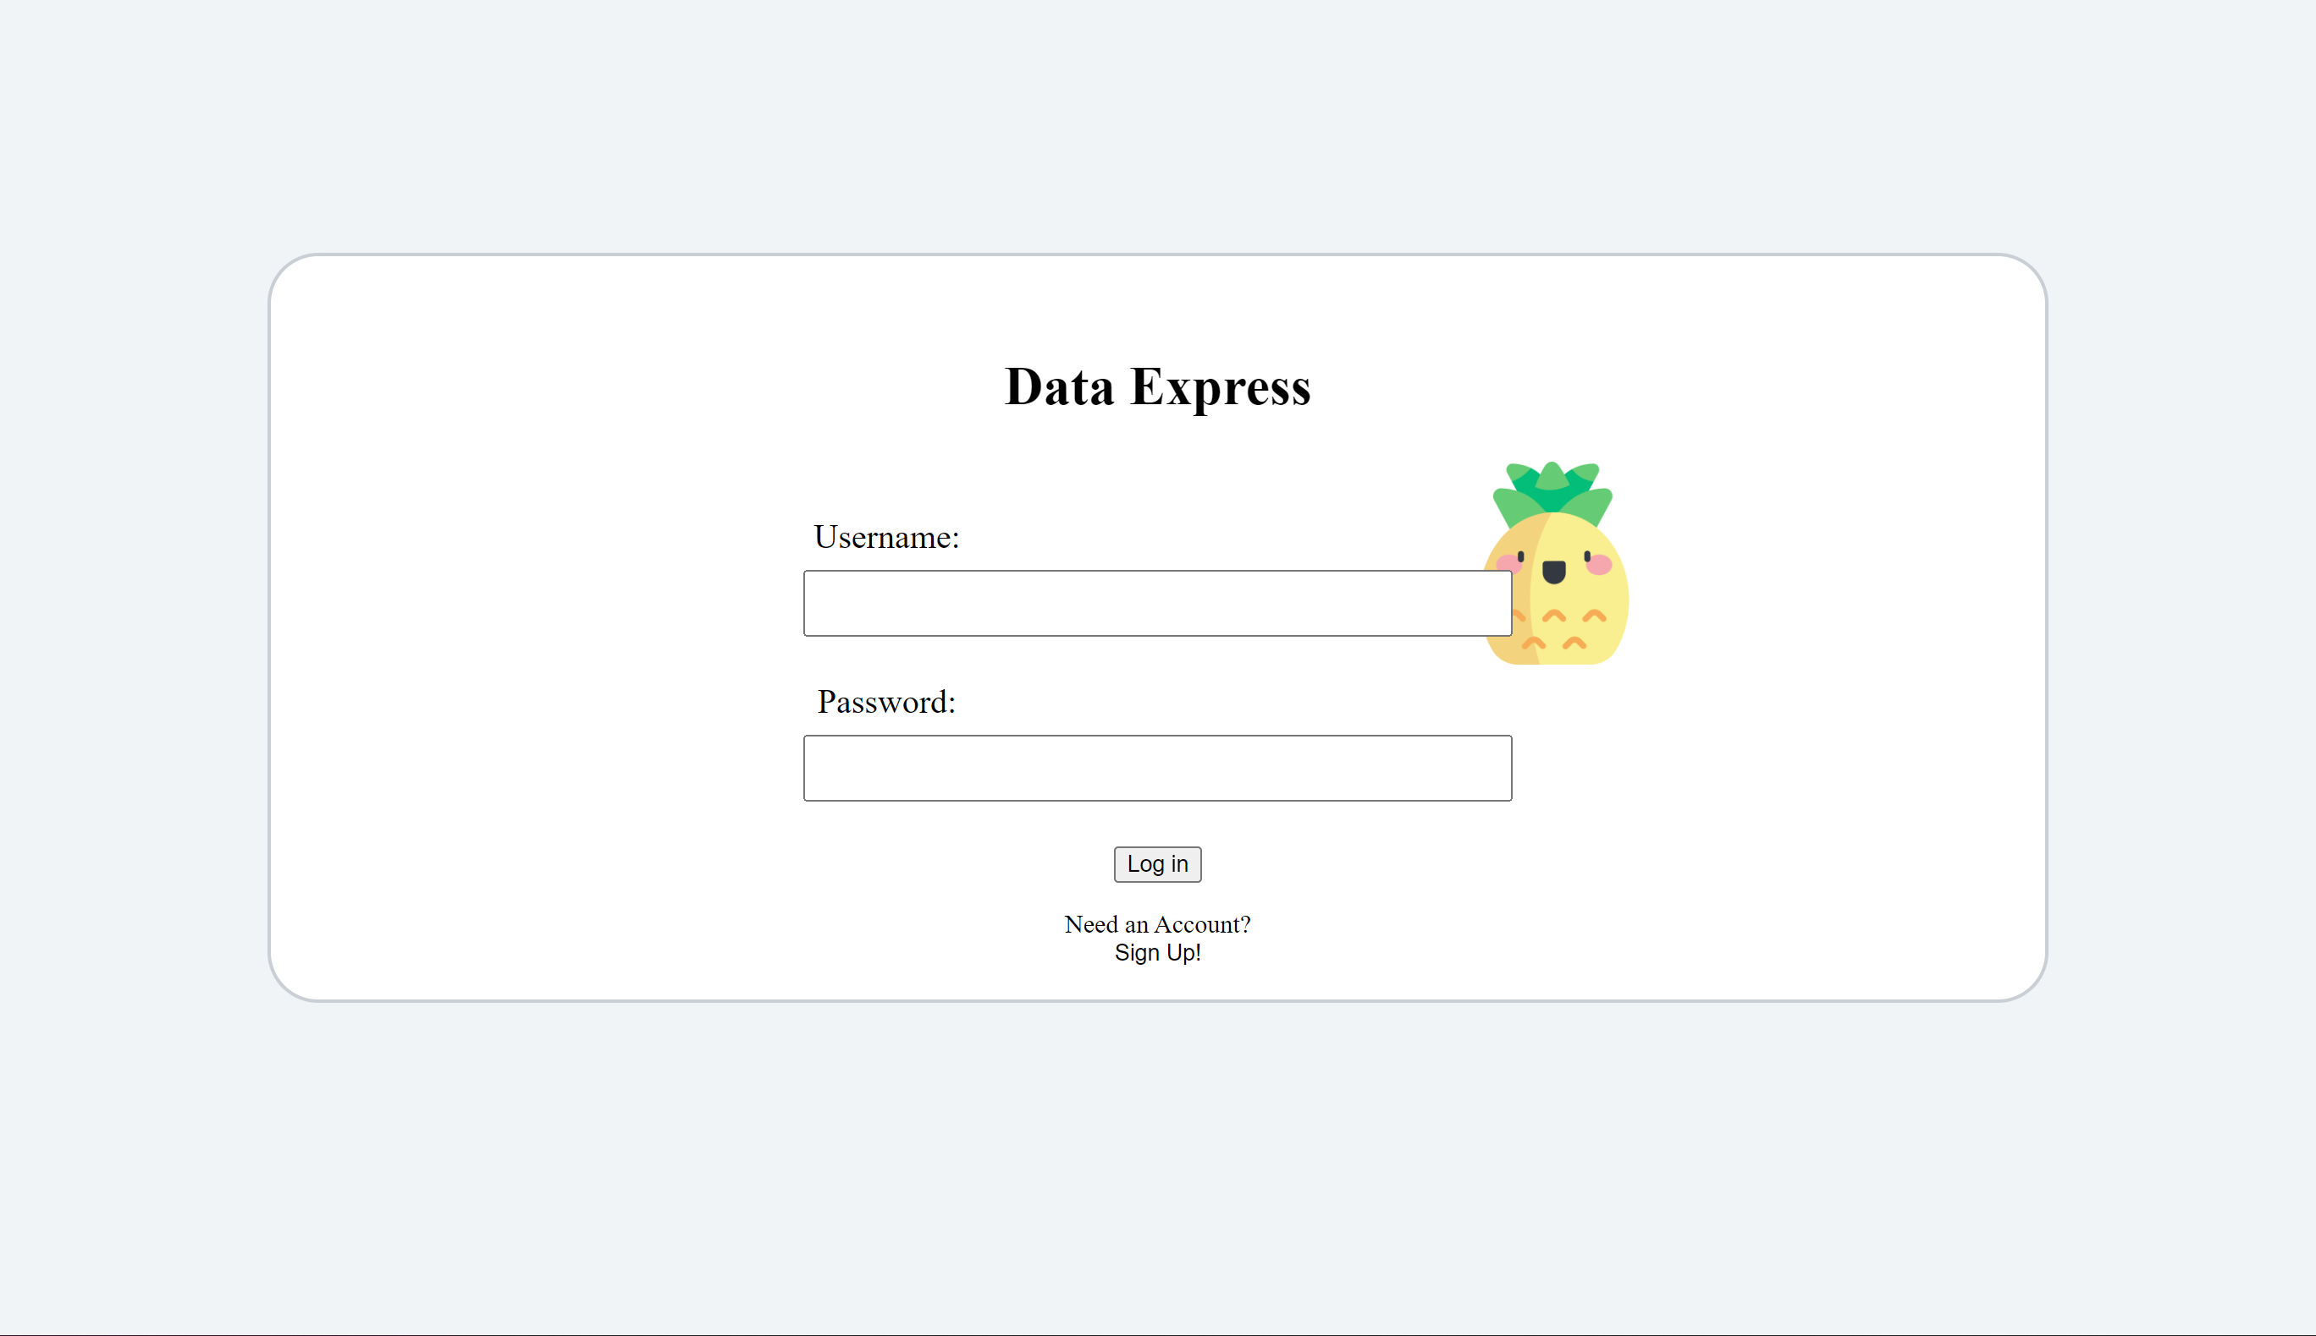
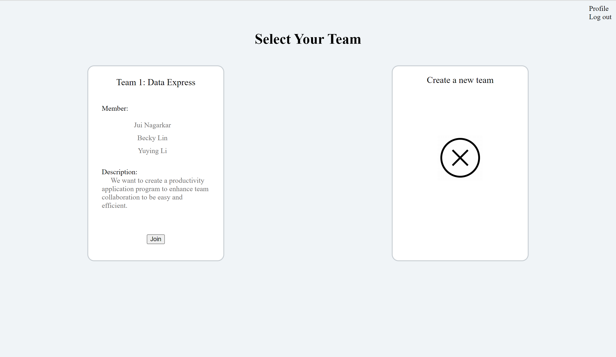
SUMMARY:
Team collaboration for any small or big project requires proper communication. Data Express is one such tool that will allow users to enjoy their team-work experience. With all the features seen in the demo collaboration will become simpler and more efficient.

Slide 7

THANK YOU!
We hope you enjoyed our presentation and find Data Express useful in your future team collaboration projects!

